Slide 1


ChowgachaUHC – Jhenaidah Sadar Hospital Model In Bangladesh.
Dr. Md.Emdadul Haque
Associate Professor (Obst & Gynae)
Ad-Din Sakina Medical College Jessore.

Slide 2
Comparative data of health facilities of different country of the world
SL NO | Country | Per capita health Expenditure per year in 2014 by Govt. ($) | Doctors per 10000 Population | Nurse per 10000 Population
01 | USA | 9536 | 25.5 | 99
02 | UK | 4356 | 28 | 84
03 | Japan | 3733 | 22.9 | 108
04 | Malaysia | 386 | 12.8 | 34
05 | Sri Lanka | 118 | 7.3 | 17.5
06 | India | 63 | 7.3 | 20.4
07 | Nepal | 44 | 8 | 4.7
08 | Pakistan | 38 | 8 | 6
09 | Bangladesh | 32 | 3.9 | 2.2
From internet 2015

Slide 3

50 BEDED UPAZILA HEALTH COMPLEX
Chowgacha, Jessore.

Slide 4
A Sub-district level Women-Friendly Hospital with a Vision …
Maximum utilization of Govt.
resources with
honesty and sincerity
Integrated approach of
Administration, Community
Leaders & Health
Management
Providing Effective and
prompt services
through improved
management system

Slide 5
Background History of Chowgacha Health Complex,Model .
To reduce Maternal and Child Mortality and Mobility and to ensure the quality services to the mother and child, UHFPO opened 4 special activities headed by medical officers in Feb. 1996. And from January 1995 to 1997 JICA helped us by Frontline MCH Program to implement the program by giving technical and logistic supports. Since 1998 DGHS & UNICEF have continued the
support.
<4 Special activities>
ANC-Corner
Basic EOC service
Under 5 corner for under 5 children
Monthly birth and death record &devlop information based responsibilites.

Slide 6



Blood donation program stared in 16 December, 1996 in Chowgacha UHC
A seminar held on basic information system at Chowgacha Degree College in June, 1997. DC Jessore was the chief guest .

Slide 7





Slide 8





Slide 9
Achievement of Chowgacha Health Complex
From 1996 to 2012, took initiatives to develop Upazilla level standard services in Chowgacha health complex.
In 2010, Chowgacha Health Complex declared as the model upazilla health complex.
  Mobilized 46 additional workers from community (26 volunteer, 12 cleaners and others 8).
  EOC Beds increased from 11 to 41
  Chowgacha UHC became the best EOC center with 98.4% delivery rate
  Chowgacha UHC achieved MDG target in 2009.
  Chowgacha Health complex is awarded for best performance in EOC form 2005 to 2014.

Slide 10

Upazila Health Complex
CHOWGACHA , JESSORE.
EOC Activities : 1997- 2011 (Hospital Delivery )

Slide 11

Upazila Health Complex
CHOWGACHA , JESSORE.
EOC Activities : 2000 - 2011 (Caesarian Section)

Slide 12
Upazila Health Complex
CHOWGACHA , JESSORE.
Comparative Data of Delivery of best performing EOC center of Khulna Division in 2011
SL No | Name of institute | NVD | Vacuum Del. | V. Breech | C. Section | Total
01. | Chowgacha UHC | 3346 | 34 | 26 | 1007 | 4413
02. | Ad-din Hospital Jessore. | 1124 | 0 | 0 | 1864 | 3492
03. | Khulna Medical College Hospital | 1581 | 58 | 18 | 1356 | 3013
04. | 250 bed Hospital, Jessore | 1327 | 2 | 25 | 1498 | 2852

Slide 13
Upazilla Health Complex
CHOWGACHA , JESSORE.
COMMUNITY SUPPORTED MANPOWER
TOTAL :46
  Volunteers :26
  Cleaners & guards :16
  Others :04
  The remunerations come from
  Outsourcing :25
  Service provider :21
  The amount of remuneration ranging from 200/= To 8000/=tk. Per month depending upon the style of work, which costs a total of nearly 90,ooo/=Tk per month.

Slide 14
MDG 4 and 5 Achieved at Chowgacha in 2011 and SDG targets in 2030
Per 1000 live Birth Chowgacha MDG Target SDG Target
MMR: .68 1.47 .70
(MDG 5 Achieved)
NNMR: 18.2 - 12
IMR: 23.6 31 -
(MDG 4 Achieved)
<5 MR: 25.7 50 25
(MDG 4 Achieved)

Slide 15






Slide 16
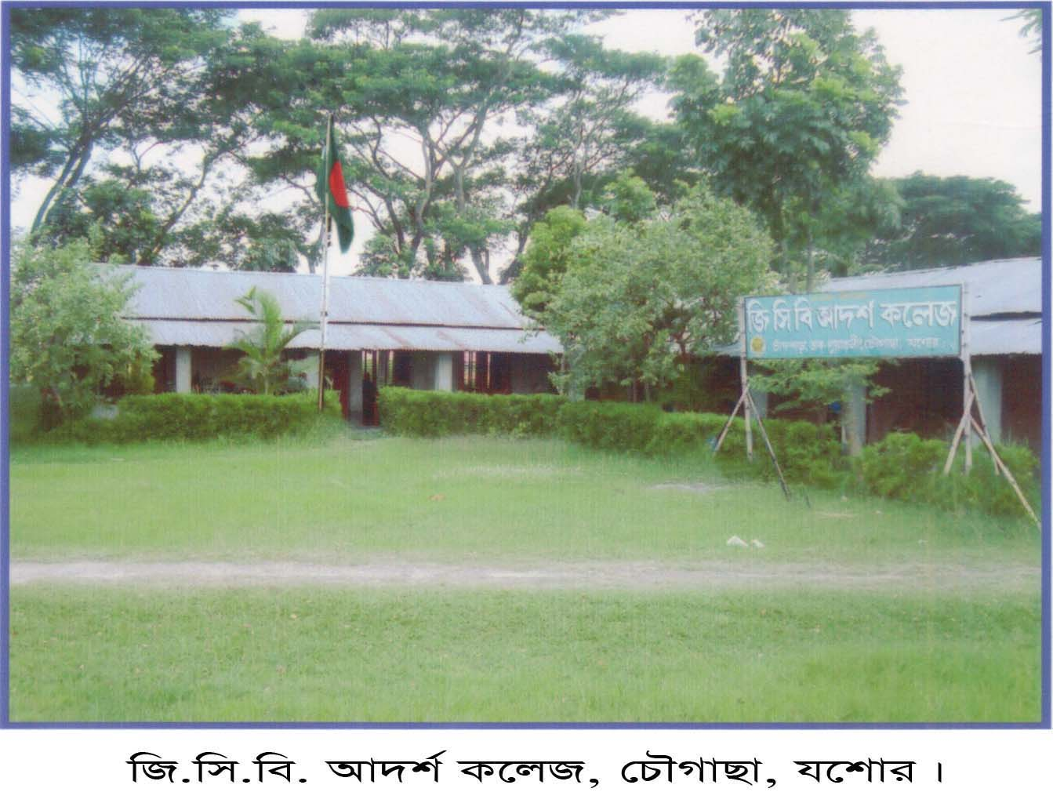
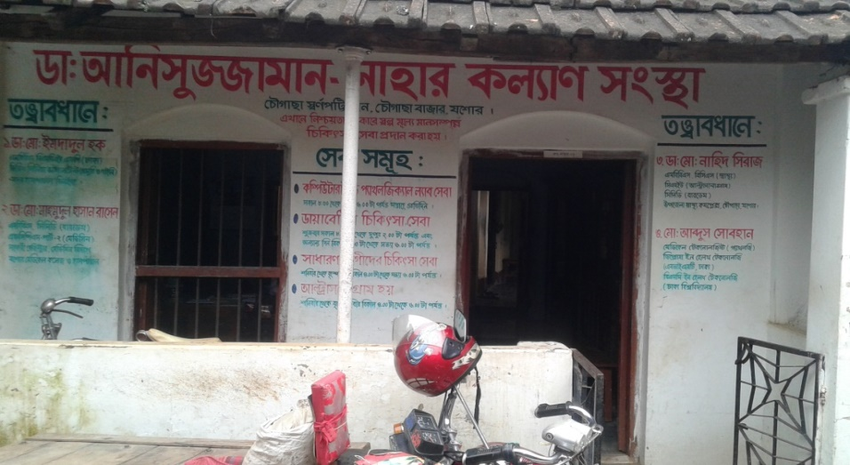

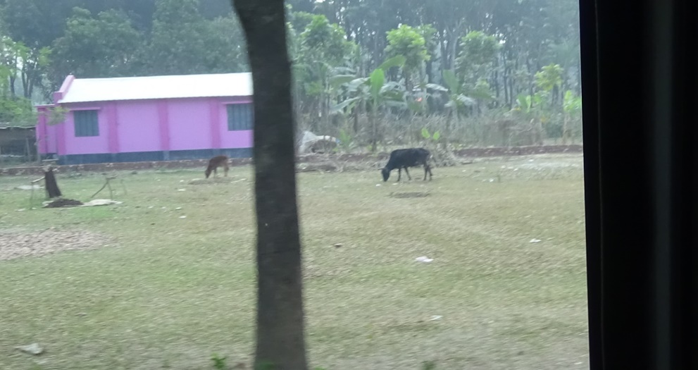
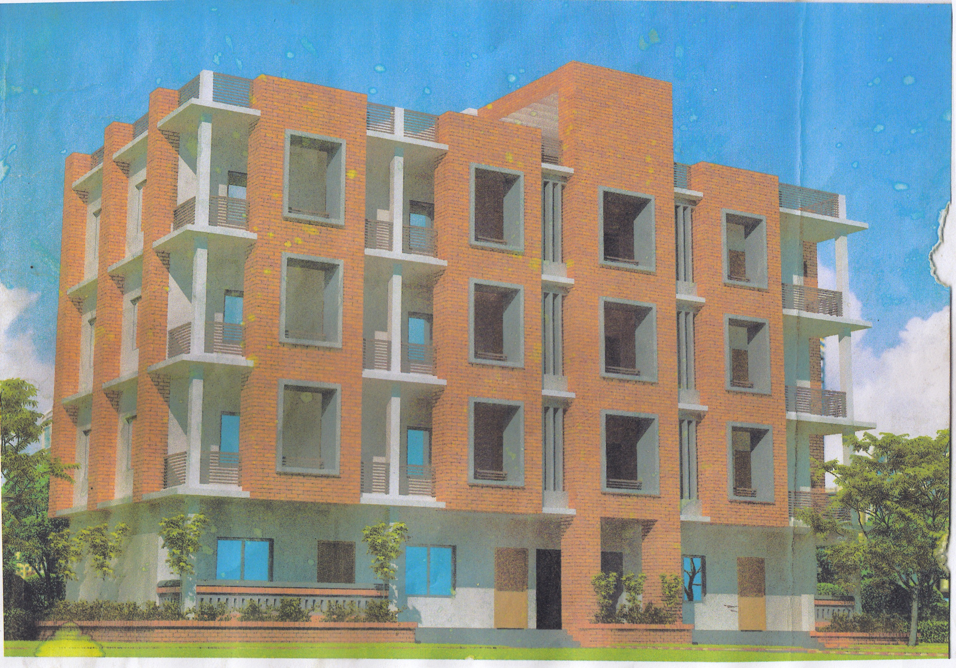
Activities of Local Industrialist

Slide 17

100 kh¨v wewkó m`i nvmcvZvj, wSbvB`n

Slide 18
Sadar Hospital, Jhenaidah
Important post of Human Resources
Serial No. | Person | Post | Vacant
01 | Doctor | 40 | 11
02 | Nurse | 63 | 03
03 | MLSS, Ward boy, Ayah | 16 | 0
04 | Cleaner | 07 | 00
05 | Guard | 03 | 00
06 | Gardener | 01 | 00
07 | Electrician | 01 | 00
08 | Trolley man | 00 | 00
09 | Others | --- | ---
 | Total | 151 | 31

Slide 19

Sadar Hospital, Jhenaidah
Bed Occupancy Rate from 1998 to 2017

Slide 20
Emergency & Out Door, Indoor Service 1998 to 2017
Sadar Hospital, Jhenaidah

Slide 21
Operation Service (Major) 2011 to 2017
Sadar Hospital, Jhenaidah

Slide 22
Sadar Hospital, Jhenaidah
Admitted Under 5 children in indoor from 2014 to 2017

Slide 23
Upazila Health Complex
CHOWGACHA , JESSORE.
Comparative Data of Delivery of best performing EOC center of Khulna Division in 2017
SL No | Name of institute | ANC | NVD | C. Section | Total
01 | Jhenaidah Sadar Hospital | 15360 | 1839 | 1143 | 2997
02 | 250 bed Hospital, Jessore | 13152 | 1327 | 1778 | 2967
03 | Chowgacha UHC | 18650 | 2163 | 759 | 2922
04 | Khulna Medical College Hospital | 6977 | 1455 | 1228 | 2683
05 | 250 Bedded Hospital, Kushtia | 4735 | 1595 | 919 | 2514

Slide 24
Comparative data of revenue income (in Taka) from 2015 to 2017
Sadar Hospital, Jhenaidah

Slide 25
Community Support System in Sadar Hospital
53 manpower (Cleaner 20, Ayah & ward boy 21, Guard 6, Volunteer 3, Trolley man 3 ) is supported by the community.
MP of Jhenaidah-2 donated 14 manpower support.
Chairman of Zahedee foundation supports 12 manpower and an intercom with a cost of nearly two lac taka.
Mayor of Jhenaidah Paurasava plays an important role in security , cleanliness, repaired the boundary wall and supports 5 man power and renovation of pediatric word and donation of a biochemistry analyzer at a cost of 1,15,000 Taka.
Retired secretary donated a generator for 24 hours OT service with a cost of nearly 33 thousand taka.
Doctors of the hospital and Jhenaidah town supports 17 man power.

Slide 26




Visit to Shatkhira District Hospital and Introduction of TQM activities

Slide 27




Changes in EOC Ward
Before
After
Before
After

Slide 28








Changes in Surgery & Pediatric Word

Slide 29





Changes in Gardens of The Hospital
Before
After
Before
After

Slide 30




Waste Management & Campus Protection
Before
After
Before
After

Slide 31




Use of direction sign, labeling of rooms, clean latrine and waste segregation
Use of direction sign
Labeling of rooms
waist segregation
Clean latrine

Slide 32




Use of color code, alignment of picture & continuous big cleaning day
Color code
Color code
Alignment of pictures

Slide 33




Innovative activities of Jhenaidah Sadar Hospital - 1
Reception room
Creation of nursing aid
Health education session
Community engagement

Slide 34




Innovative activities of Jhenaidah Sadar Hospital - 2

Slide 35




Innovative activities of Jhenaidah Sadar Hospital - 4

Slide 36




Innovative activities of Jhenaidah Sadar Hospital - 5

Slide 37




Involvement of MP, District Administrator & Mayor in Sadar Hospital

Slide 38




Internal Monitoring System
Meting of health improvement committee
Meting of community support group committee
QIC meeting
Monthly meeting schedule

Slide 39




Improved pediatric ward by local initiative

Slide 40




Hospital Environment

Slide 41
Jhenaidah Sadar Hospital, Jhenaidah
Achievement of the Hospital
1. Active Community Participation in health service is an example in Bangladesh.
2. Improved performance of all services specially Pediatric, obstetric, operation and outdoor service.
3. Improved Cleanliness and Beautification of Campus.
4. Functioning of X-Ray service and starting of Biochemistry investigation by local initiatives.
5. Improved Security.
6. Improved Financial Management
7. Piloting of “Model District Hospital” is running in Jhenaidah Sadar Hospital.
8. The hospital is awarded 5 times from 2013 to 2017. Stood first award by 5S-KAIZEN-TQM among the 100 bedded district hospitals by defeating Norsindi Sadar Hospital.

Slide 42

Thank You
Notes:
42

